Slide 1
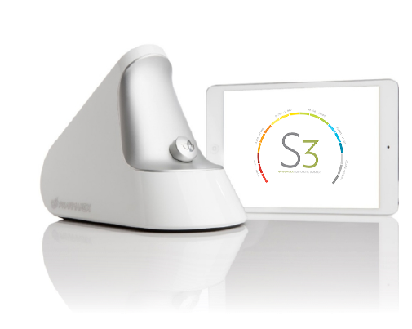




DO YOU THINK YOU’RE EMPLOYEES ARE
HEALTHY?
FIND OUT IN
30
SECONDS!

Slide 2





Employee Wellness
For The Modern Day
What Doctors Use For
Their Patients is Now Available for your Employees
Wellness
We bring the experience to you
From Your Doctor’s Perspective
Start Your Journey Towards Better Health

Slide 3


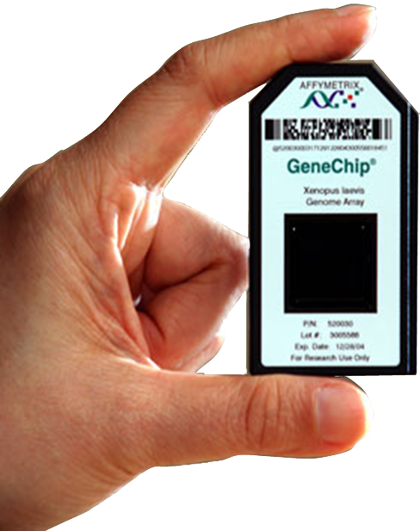
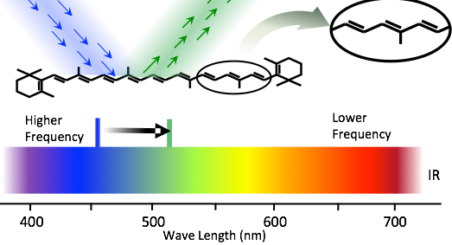
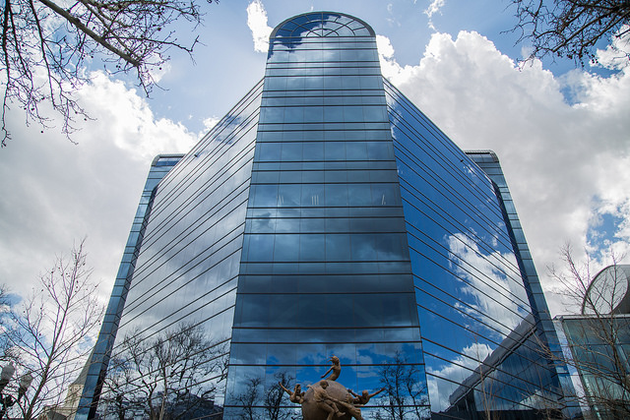



Why Choose Us?
Scientific Disciplines
$60 Million Annual
R&D Budget
Nutrition
Medicine
Pharmacology
Biochemistry
Dietetics
Chemistry
Toxicology
Immunology
Food science
Physics
Biomedical engineering
75 Full Time Scientist / 40 PHD’s
YOUNG
OLD
How We Differ?
True Epigenetics
Gene expression profile
Global Research Facilities

Slide 4











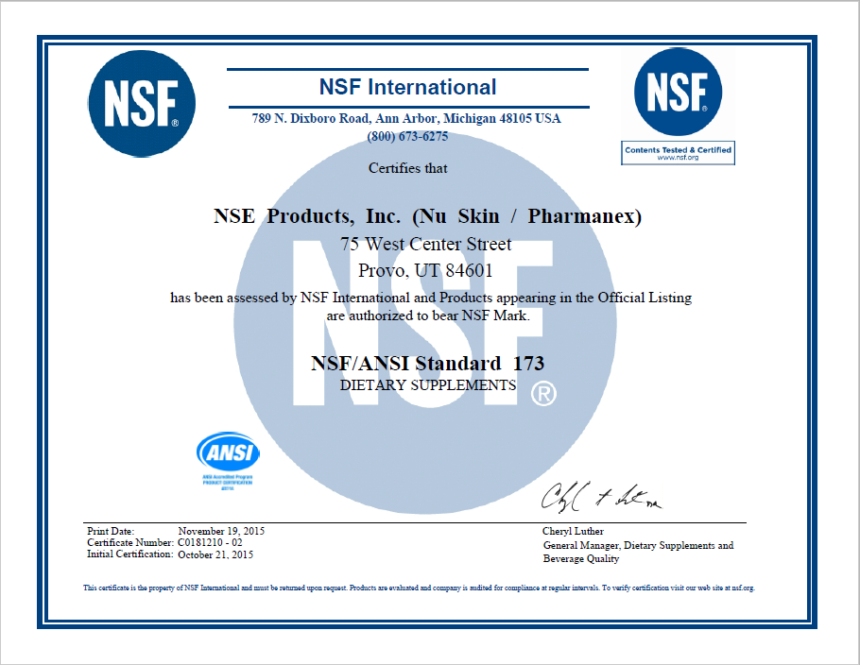



They Did.
We Only Use Registered Dietitians
Not A Certificate Holder
Visit the Site to Learn More
Not A Coach
Not A Weekend Warrior
A Registered Dietitian + There is Difference!
How this Benefits you?
Surveys found from the Employee Benefit Advisor show that the total cost of a wellness program is between $150 and $1,200 per employee per year.
90% Cheaper
than the Rest!
$AVES YOU Money
Healthier Employees
Less Sick Days
Improve Retention

Slide 5
Finally, a powerful wellness program made affordable for smaller businesses, who are the backbone of America
Access to Registered Dietitians*
Personal Link to Bio-Dietitian Website
On Site Diagnostic Testing
  Annual Testing
  Semi-annual Validation Testing for enrolled EEs
Health and Wellness Education
Monthly News Letter
Medical grade nutraceuticals with Money Back Guarantee
HSA FSA – Maximize Programs
Full Customizable Programs
* Billed separately and covered by most insurances

Slide 6
Signing up is Easy,
Just Complete This Form
Select Your Company Size
Number of EEs Annual Cost*
0-25 $150
26-50 $275
51-75 $375
76-100 $450
>100 $500
*$25 charge for each additional location
** Ask about additional options for large employers
Business Name: ______________________
Business Address: ____________________________________
Tax ID: _______________
Billing:
Credit Card Number:__________________
Expiration: _______________ CVV:_____________
Address _____________________________________________

